Slide 1
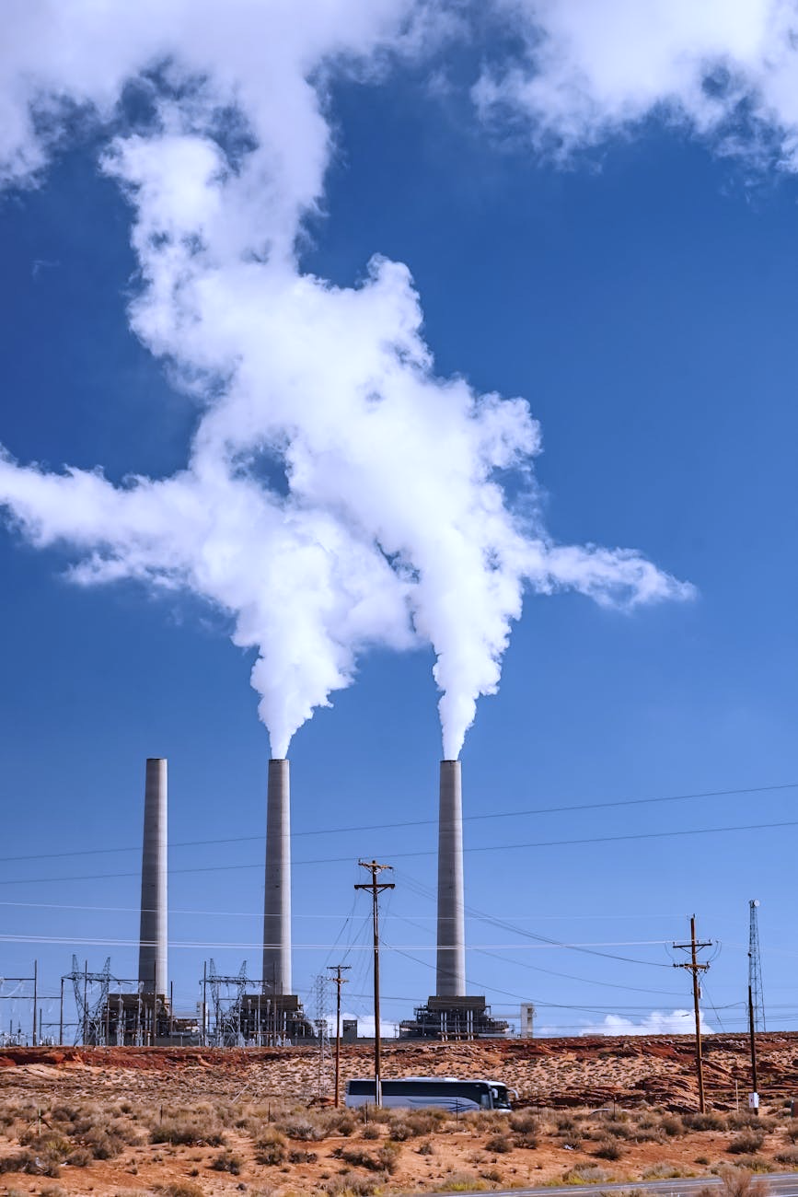

Business Intelligence and Data Modelling Final Presentation (Term 05)
Assessment of Air Quality Patterns and Key Pollution Drivers in Indian Cities
Presented by – Group 6
Chittampally Suraj (MBA24069)
Divya Bothra (MBA24077)
Gaurav Zanzad (MBA24091)
K Siva Ram Prakhash (MBA24123)
Krati Singi (MBA24129)
Mrudul Bansod (MBA24158)
Presented to
Dr. Vijaya Prabhagar
https://app.powerbi.com/groups/f6566afb-a584-4b95-9aa2-19dc1d25b936/dashboards/430594ac-aad5-43ac-851e-b3f34964918f?experience=power-bi

Slide 2
Problem Statement & Objectives
Problem Statement: Air quality across Indian cities varies widely and is increasingly influenced by particulate emissions, traffic pollutants, and seasonal weather conditions. However, the specific drivers of AQI fluctuations, their geographic patterns, and their relationship with meteorology remain unclear. There is a need for a data-driven understanding of which pollutants matter most, how weather affects pollution, and how cities cluster based on their pollution profiles to support targeted environmental actions.
Objectives
Identify the key pollutants influencing AQI
Using descriptive analysis, correlation, and Random Forest feature importance to determine dominant drivers.
2. Understand the impact of weather on pollution dynamics
Analyze temperature, humidity, rainfall, and wind patterns to assess atmospheric dispersion and seasonal effects.
3. Explore city-wise pollution profiles and geographic patterns
Use dashboards and clustering to segment cities into meaningful pollution groups for region-specific insights.
4. Examine seasonal and temporal trends in air quality
Assess winter peaks, monsoon cleansing effects, and monthly fluctuations in pollutant levels.
5. Build a predictive model for AQI forecasting
Develop a Random Forest model to evaluate how accurately pollutant concentrations can estimate AQI.
6. Derive actionable insights for policy and intervention
Translate findings into targeted recommendations to reduce particulate and traffic emissions and optimize season-aware strategies.

Slide 3
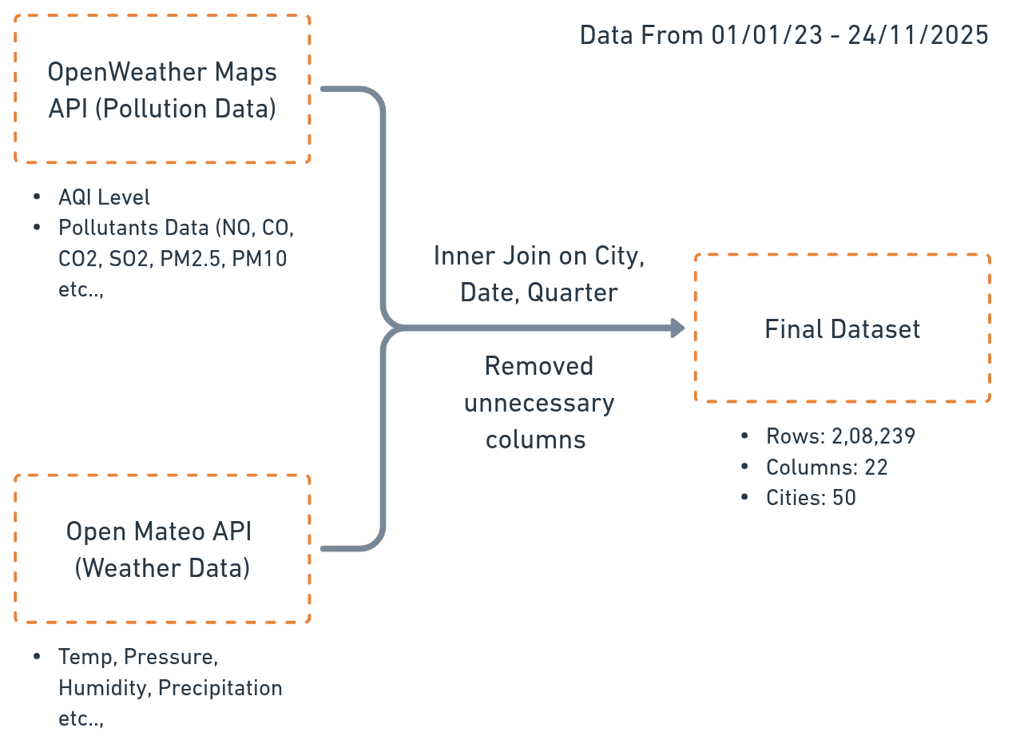
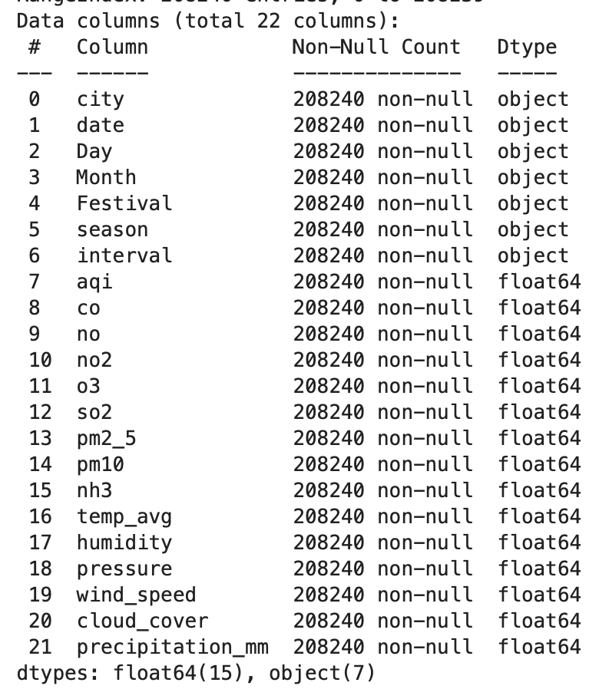
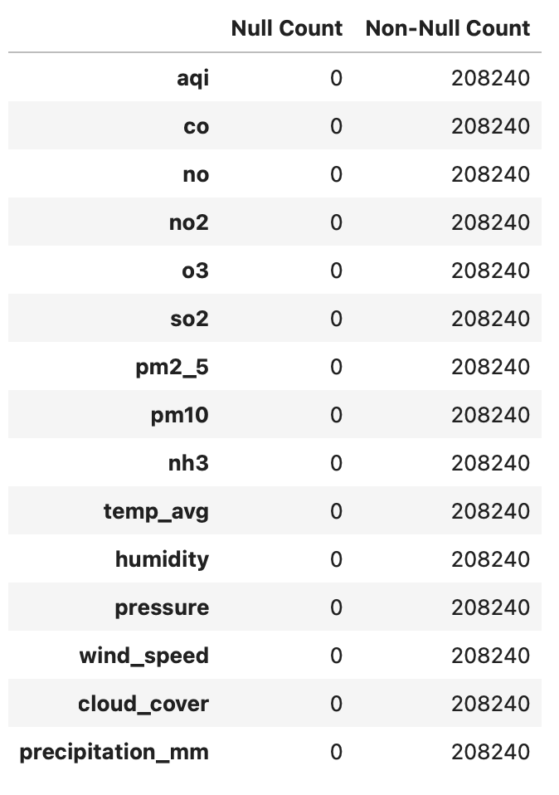
About the Data
Data Extraction Methodology
Data Info
Null Count

Slide 4
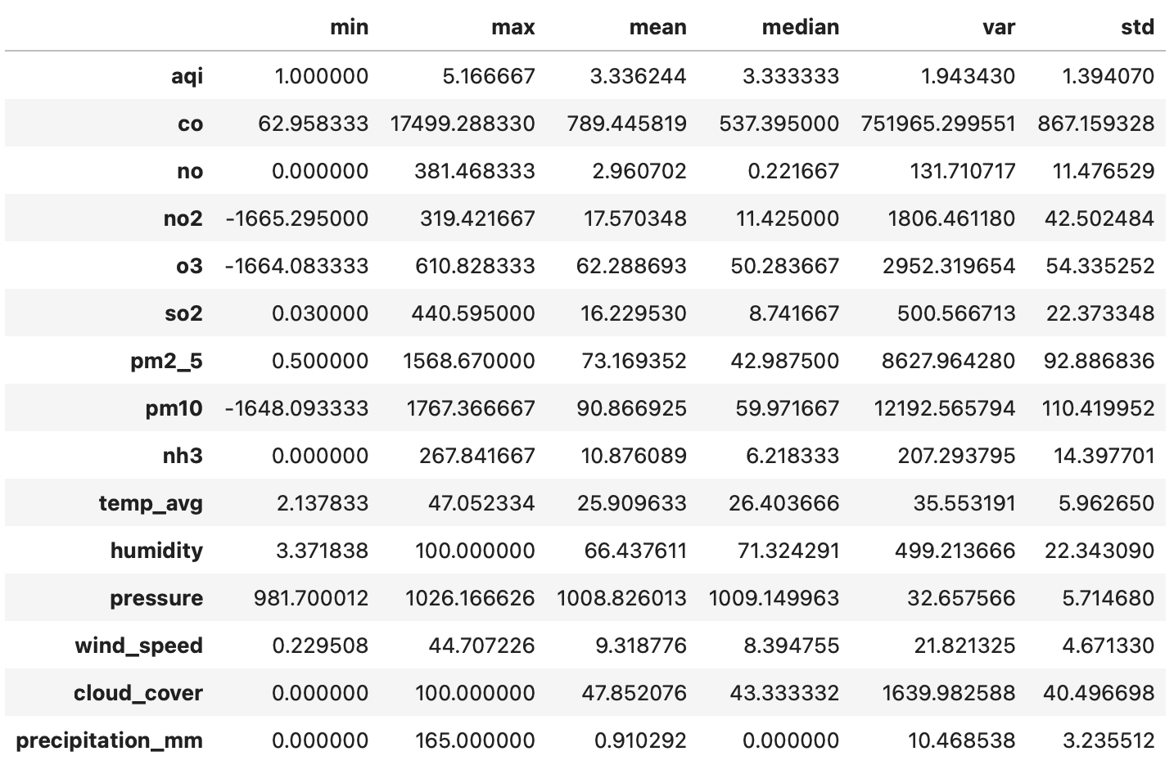
Descriptive Statistics & Correlation
Descriptive Statistics
Correlation Matrix
Note:
Negative Values of NO2 (100), O3 (50) and PM10 (50) might be an effect of Sensor/Processing Issues. Not deleted since the effect of them will be minimal on a dataset with >2 lakh records
AQI max of 5.1667 is also a processing error from API. Ignored since only 3 in number

Slide 5


Report 1: AQI & Pollution Overview

Slide 6
Report 2: Weather Analysis & Climate Insight Dashboard (City-wise)

Slide 7
Report 3: Seasonal and Temporal Analysis

Slide 8
Report 4: Geographic Deep Dive & City Comparison

Slide 9
Report 5: Clustering Cities by Pollution Metrics

Slide 10
Report 6: Feature Importance using Random Forest

Slide 11

Conclusions & Call to Action
PM2.5, PM10, and CO are the dominant drivers of poor air quality in Indian cities
Consistently high correlations, feature importance rankings, and predictive impact confirm that particulate emissions and traffic-related pollutants account for most AQI variation.
Weather conditions significantly moderate pollution levels
Negative correlations with temperature, wind, humidity, and rainfall show that dispersion and monsoon effects naturally improve AQI, highlighting strong seasonal dependencies.
City-level pollution patterns are not uniform
Cluster analysis reveals three distinct city groups—low-pollution coastal/elevated cities, high-pollution Indo-Gangetic belt cities, and mixed metropolitan cities—indicating region-specific sources and policy needs.
Machine learning models can reliably predict AQI
The Random Forest model (R² > 0.9) demonstrates that pollutant concentrations alone are sufficient for accurate AQI prediction, enabling data-driven forecasting and decision support.
Integrated evidence supports targeted and season-aware interventions
Since particulate pollution dominates and peaks during winter, prioritizing PM control, traffic emission reduction, and pre-winter policy actions can drive the most effective improvements.
CALL TO ACTION
Focus on PM2.5/PM10 reduction through dust control and emission regulation.
Strengthen traffic emission policies to tackle CO and NOₓ clusters.
Apply region-specific strategies guided by cluster segmentation.
Plan interventions seasonally—intensify actions before winter peaks.
Use predictive AQI models for early warnings and faster responses.
Enhance air-quality monitoring and data reliability.

